Slide 1
Artificial Neural Networks - supervised learning technique
Jayaraj P B
1

Slide 2
Outline
History of Neuron Development - Recap
Perceptron & Neural Networks
Forward & Backward Propagation
Activation functions for NN
Cost Function for NN

Slide 3
Introduction
The main property of a neural network is an ability to learn from its environment, and to improve its performance through learning.
So far we have considered supervised or active learning − learning with an external “teacher” or a supervisor who presents a training set to the network.
But another type of learning also exists: unsupervised learning.

Slide 4
Historical Background - Summary
Early attempts to implement artificial neural networks: McCulloch (Neuroscientist) and Pitts (Logician) (1943)
Based on simple neurons (MCP neurons)
Based on logical functions
Donald Hebb (1949) gave the hypothesis in his thesis “The Organization of Behavior”
Frank Rosenblatt (1958) created the perceptron, an algorithm for pattern recognition based on a two-layer computer learning network using simple addition and subtraction .
[1]
[1]

Slide 5
Historical Background - Summary
However, neural network research stagnated when Minsky and Papert (1969) criticized the idea of the perceptron discovering two key issues in neural networks:
Could not solve the XOR problem.
Training time grows exponentially with the size of the input.
Neural network research slowed until computers achieved greater processing power.
Another key advance that came later was the back propagation algorithm which effectively solved the exclusive-OR problem (Werbos 1975).
[1]
[1]

Slide 6
Perceptron
Is a single-layer neural network used for simple operations
Used for supervised learning of binary classifiers
Binary classifiers decide whether an input, usually represented by a series of vectors, belongs to a specific class
Further expanded with ‘back propagation’ technique used for efficient multi-layer network training

Slide 7
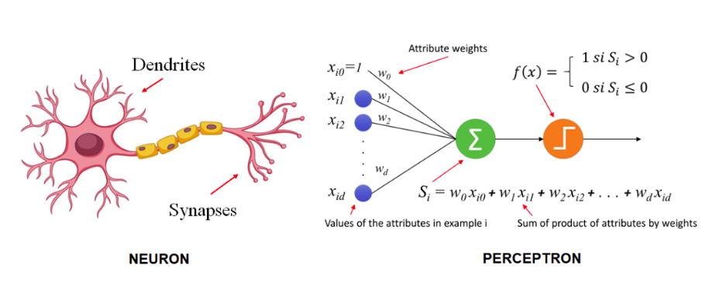

Slide 8
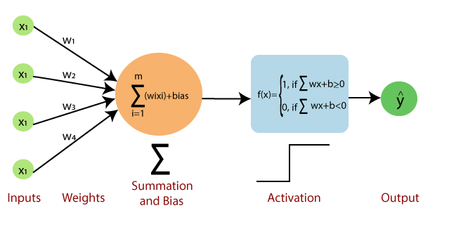
Perceptron

Slide 9
Structure of a Neuron
X
1
3
Z = ∑ W_{i}X_{i} + B
i=1
3
A( ∑ W_{i}X_{i} + B)
i=1
X2
A(Z)
X
3
X{1,2,3}
W{1,2,3}
= Input
= Weight
B = Bias
A = Activation Function

Slide 10
Perceptron Limitations
The perceptron is useful for classifying data sets that are linearly separable.
They encounter serious limitations with data sets that do not conform to this pattern as discovered with the XOR problem.
The XOR problem shows that for any classification of four points that there exists a set that are not linearly separable.

Slide 11
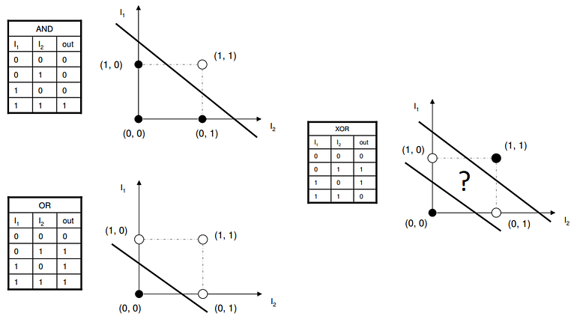

Slide 12
Multi-Layer Perceptron
The MultiLayer Perceptron (MLPs) breaks this restriction and classifies datasets which are not linearly separable.
by using a more robust and complex architecture to learn regression and classification models for difficult datasets.
MLPs have the same input and output layers but may have multiple hidden layers in between the input and output layers

Slide 13
Artificial Neural Network
Putting artificial neurons together to create an artificial brain
A set of neurons are organized in a layer, each network consists of multiple layers of these neurons. Each neuron of a layer is connected with each neuron of the adjacent layer. Hence the outputs of all neurons in a layer are passed as input to the next layer.

Slide 14
Structure of a Neural Network
Inputs
Input Layer
Hidden Layer
Output Layer
Just like how a massive network of neurons create the brain, a network of artificial neurons create an Artificial Neural Network.

Slide 15
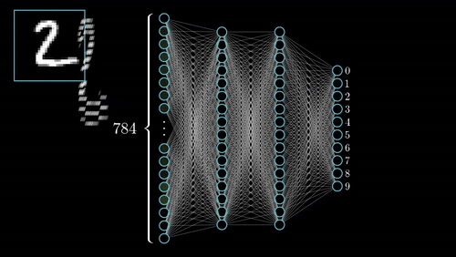
An example of a learning pass

Slide 16
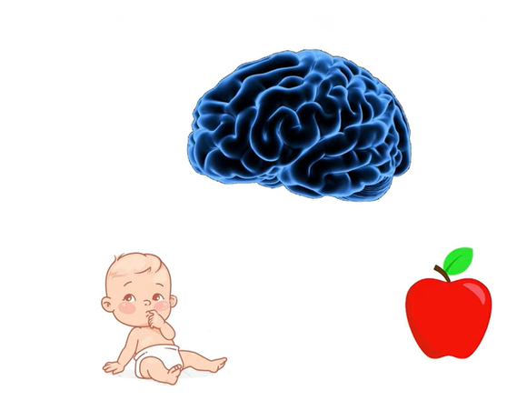
How does a child learn

Slide 17
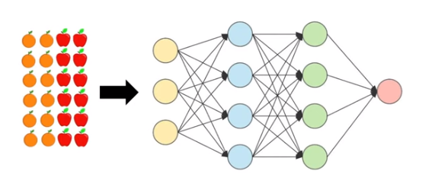

Slide 18
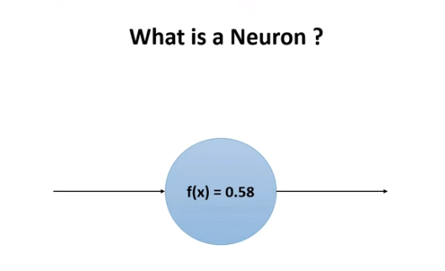

Slide 19
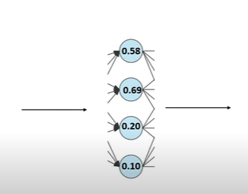
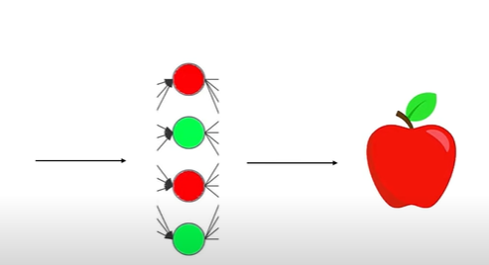
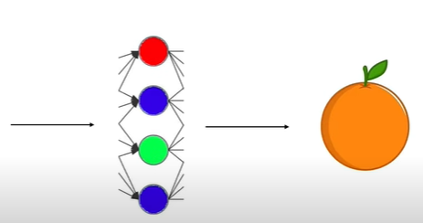

Slide 20
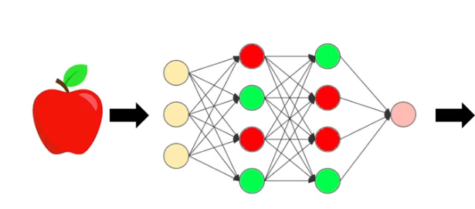
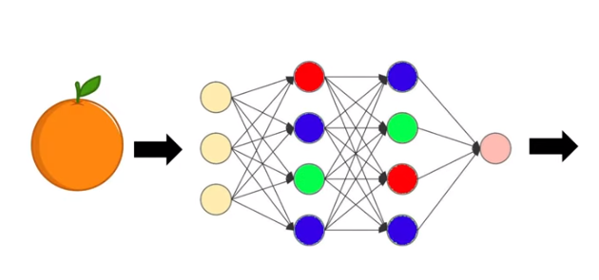

Slide 21
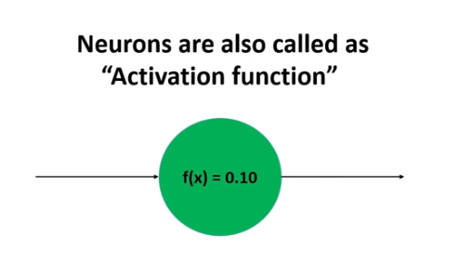

Slide 22
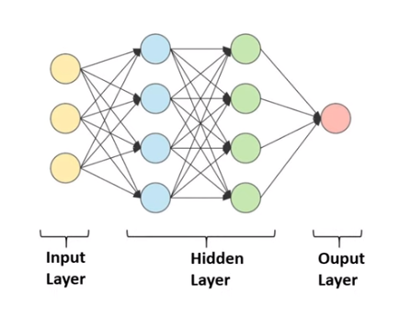

Slide 23
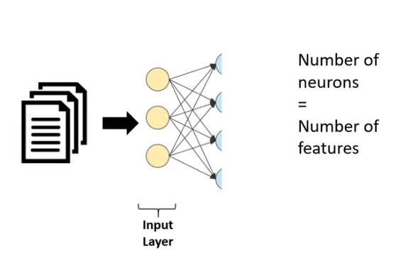

Slide 24
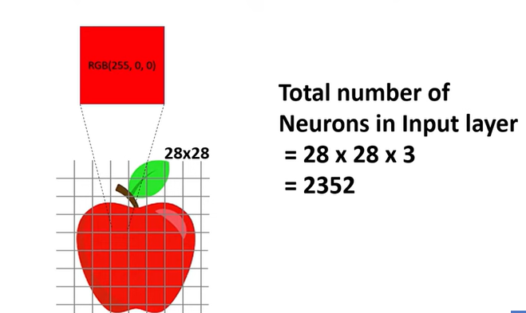

Slide 25
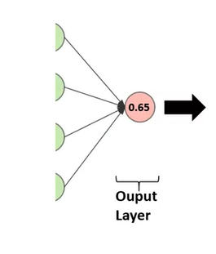

Slide 26
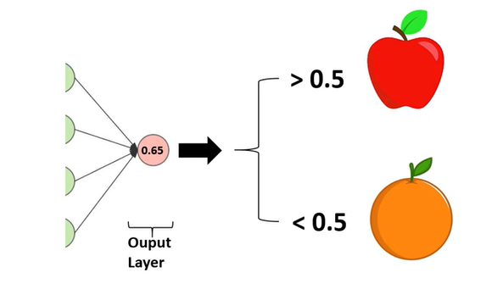

Slide 27
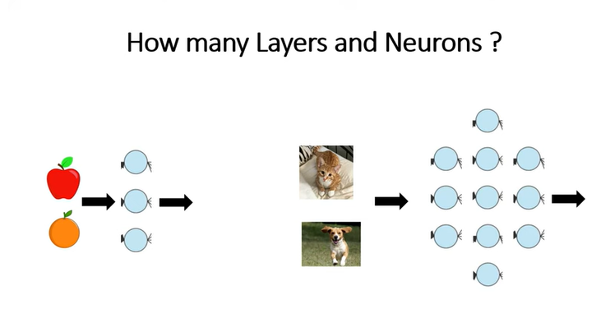

Slide 28
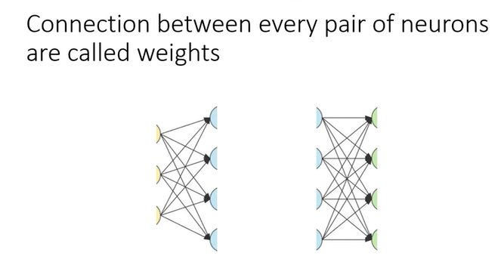

Slide 29
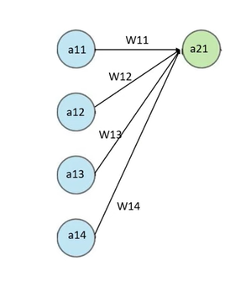

Slide 30
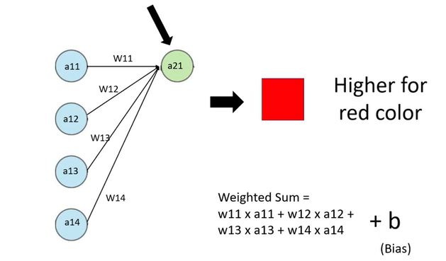

Slide 31
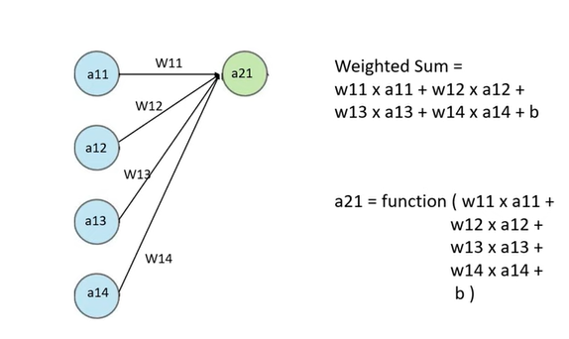

Slide 32
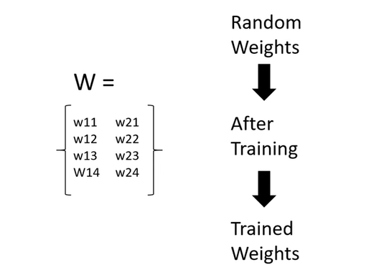

Slide 33
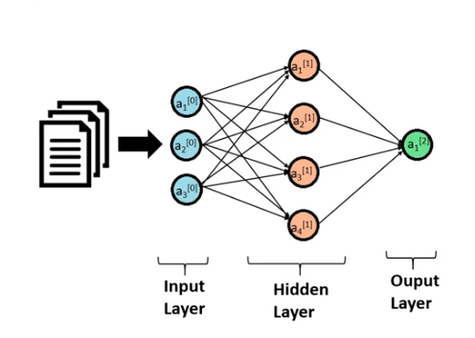

Slide 34
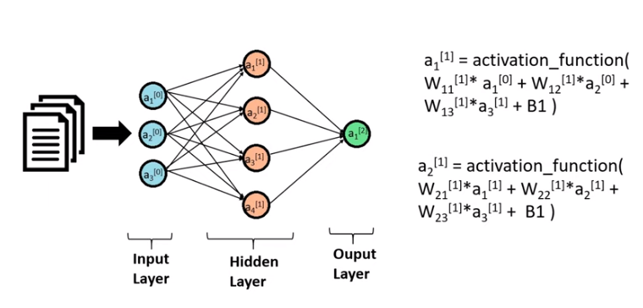

Slide 35
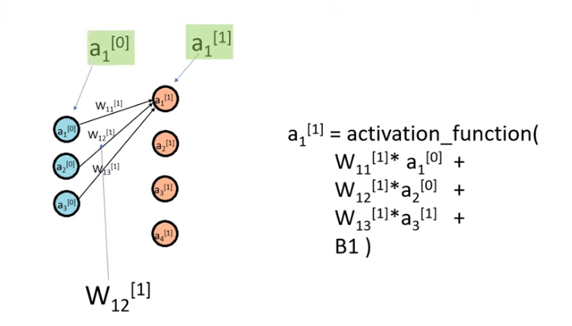

Slide 36
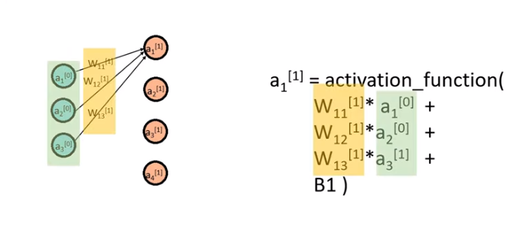

Slide 37
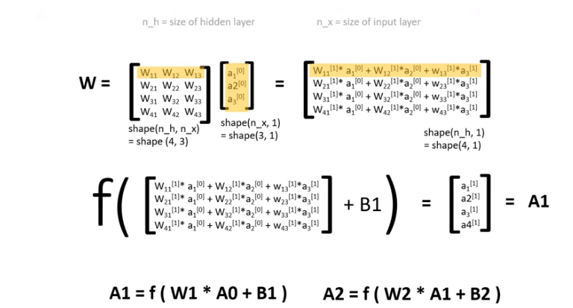

Slide 38
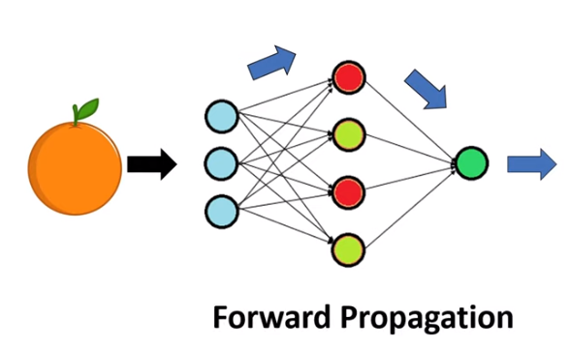

Slide 39
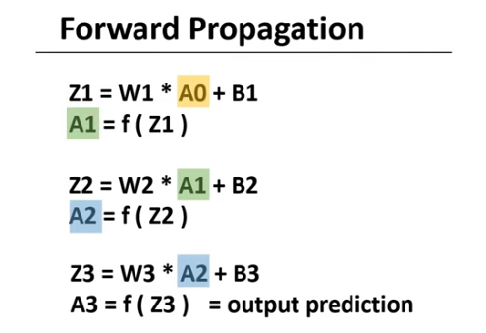

Slide 40
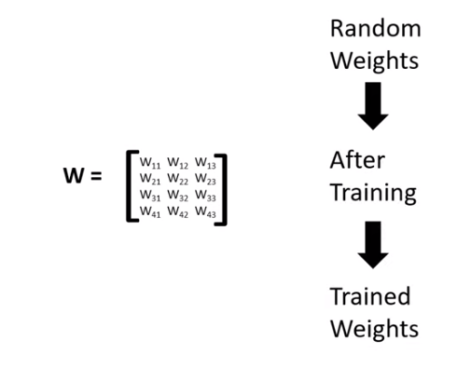

Slide 41
Activation Function in Artificial Neural Networks
An Activation Function decides whether a neuron should be activated or not.
It’s just a function that you use to get the output of node. It is also known as Transfer Function.
This means that it will decide whether the neuron's input to the network is important or not in the process of prediction.
Usually, each layer consists of a function that multiplies the input by a weight and adds a bias.
It maps the resulting values in between 0 to 1 or -1 to 1 etc.

Slide 42
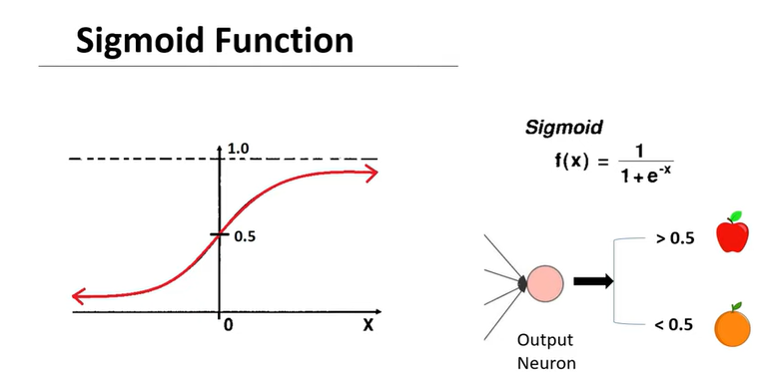
Activation Functions

Slide 43
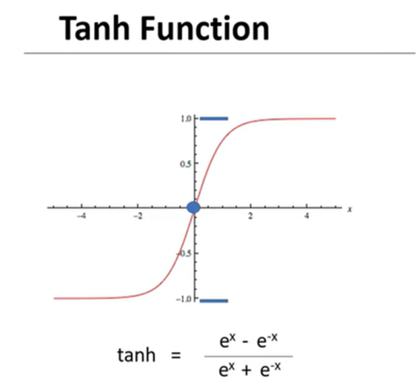

Slide 44
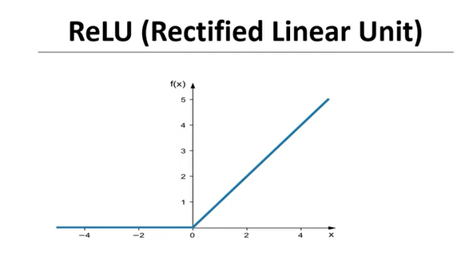

Slide 45
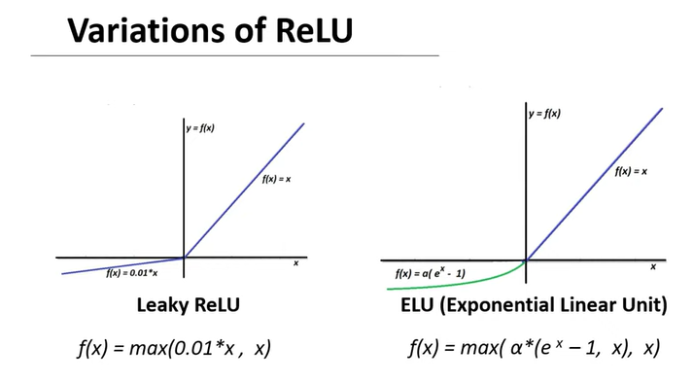

Slide 46
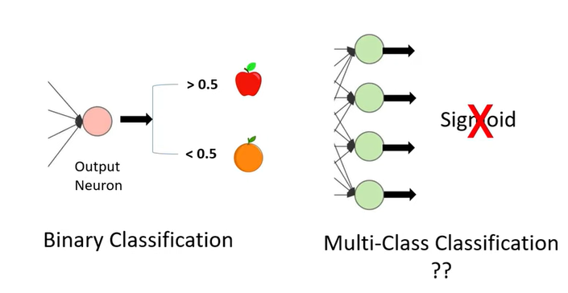

Slide 47
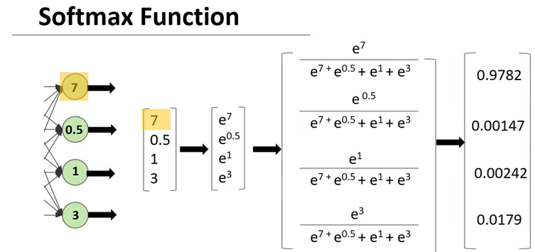

Slide 48
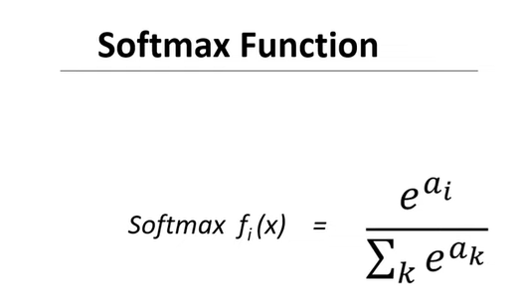

Slide 49
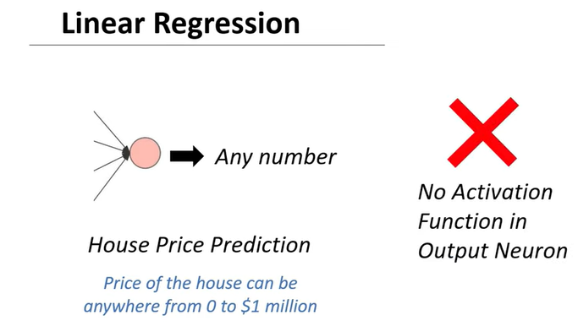

Slide 50
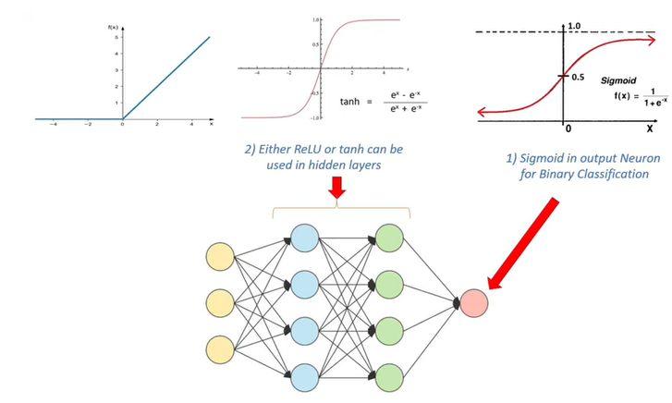

Slide 51
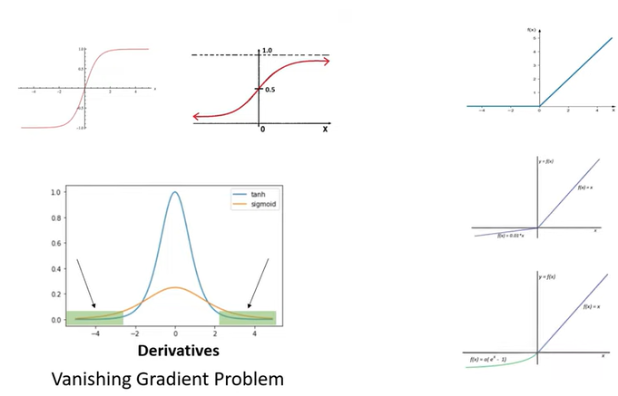

Slide 52
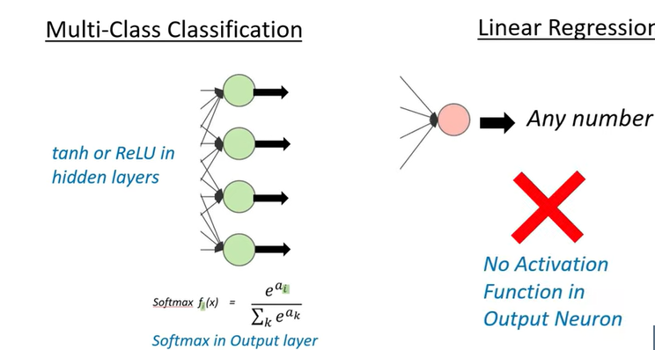

Slide 53
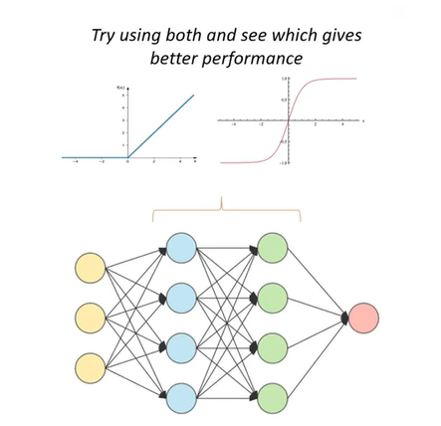

Slide 54
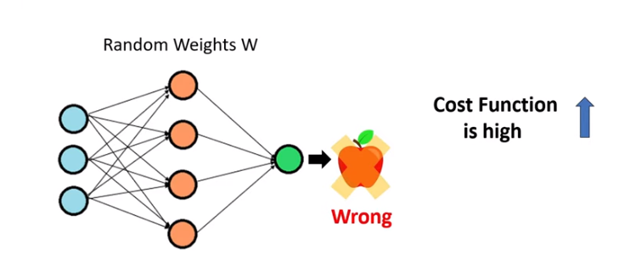

Slide 55
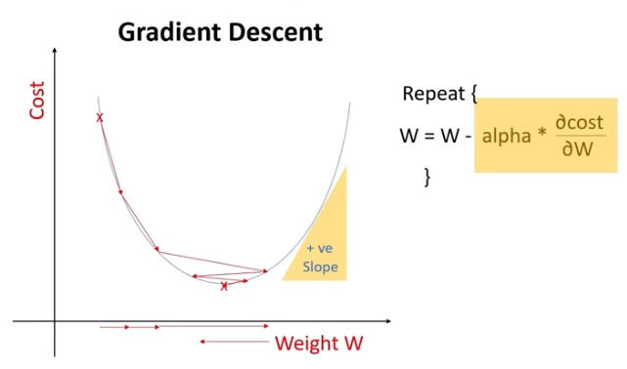

Slide 56
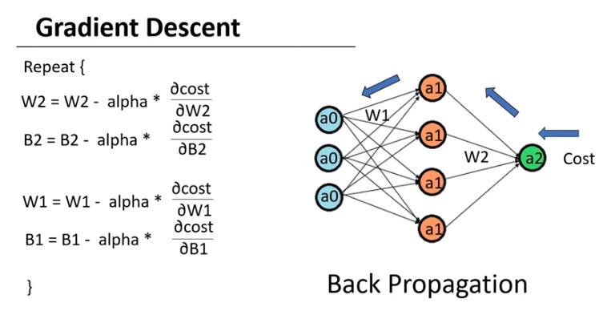

Slide 57
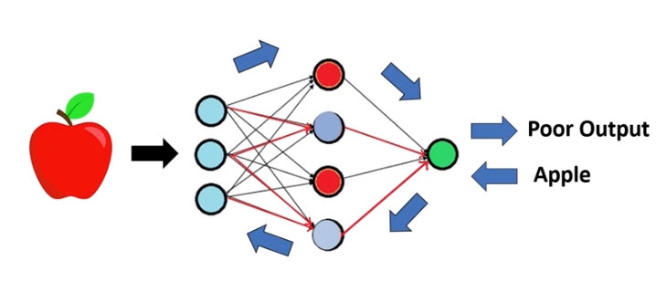

Slide 58
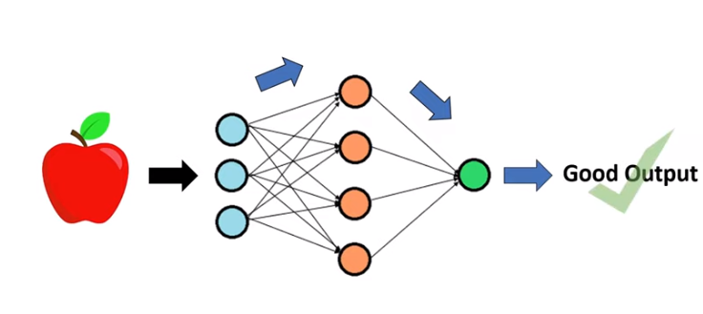

Slide 59
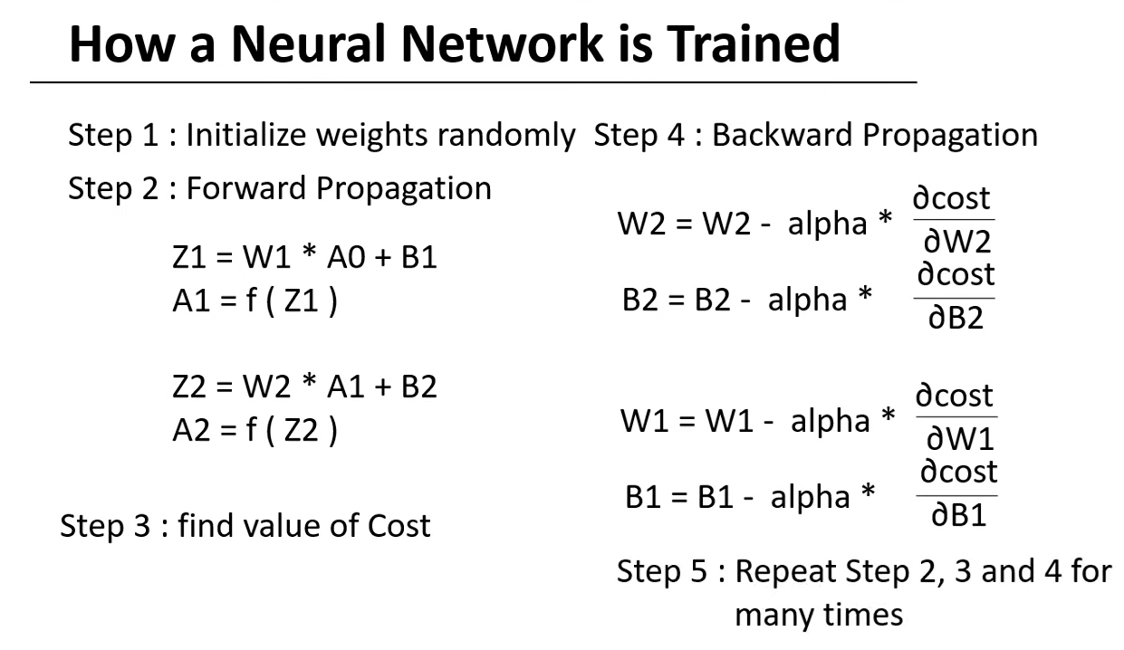

Slide 60


Slide 61


Slide 62


Slide 63


Slide 64


Slide 65


Slide 66


Slide 67

Back Propagation is the essence of neural net training. It is the practice of fine-tuning the weights of a neural net based on the error rate (i.e. loss) obtained in the previous epoch (i.e. iteration). Proper tuning of the weights ensures lower error rates, making the model reliable by increasing its generalization

